Slide 1
Chapter 2
The Application Layer
Notes:
Network applications are behind the transformative power of the Internet. Without them the Internet would be just a fast way to send information, only slightly better than the fax machine.
What attributes of the Internet make it different?
- Responsiveness
-- The near real-time nature of Internet connectivity allows interactive applications
- Throughput
-- High enough to allow multimedia
- Generality
-- Allow the implementation of different types of distributed systems on simple services provided by networking protocols
Limitation of the Internet architecture?
- No guaranteed transmission rate
- No guarantees on end-to-end delay

Slide 2
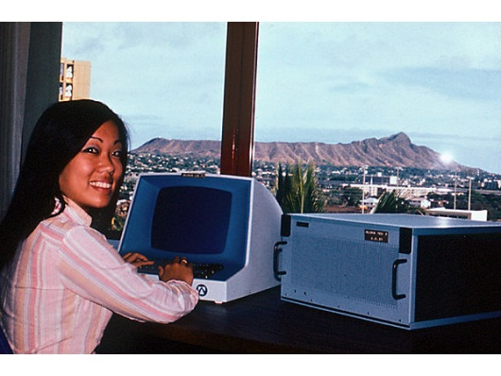
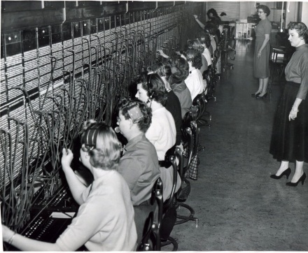
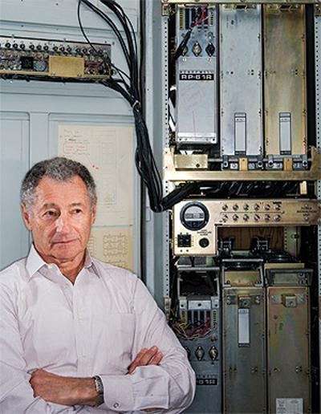
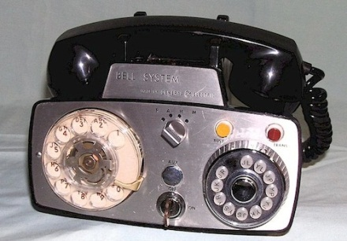
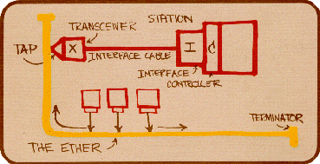




Internet evolution
Circuit switched nets
Packet switched nets
Proprietary nets and internetworking
ALOHAnet
Internetting
network of networks
Inefficient with bursty traffic
ARPAnet runs NCP (RFC001)
First email
Leonard Kleinrock
pre 1960
1961
1969
1972
1980
4 nodes
15 nodes
100 000 nodes

Slide 3
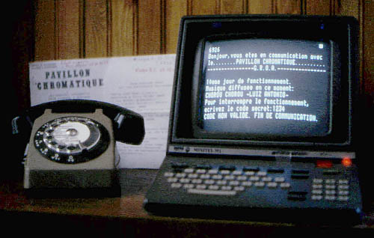
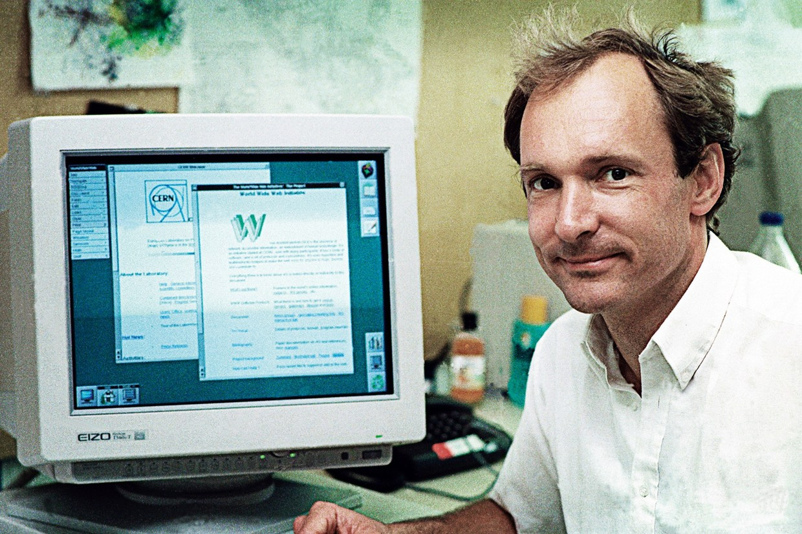
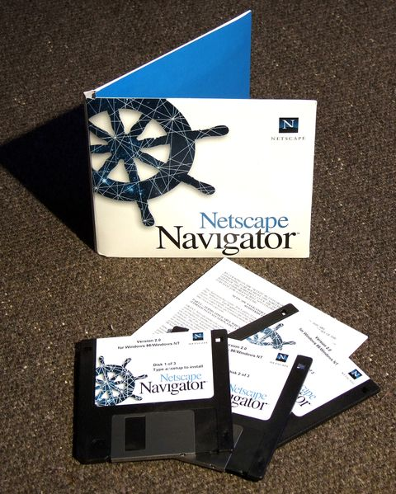
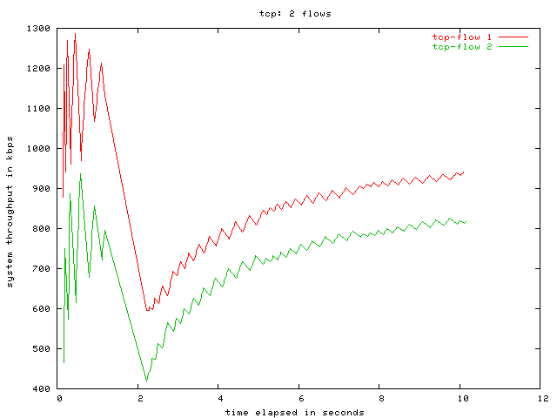
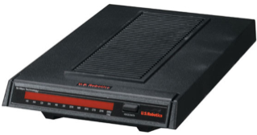

Internet evolution cont.
Proliferation of networks
The Internet Explosion
ARPAnet
Minitel - 1984
BITNET
TCP/IP
CSNET
NSFNET
DNS
Tim Berners-Lee
Jan 1st, 1983
Public Internet - 1991
Hypertext and the Web
E-mail, IM, peer-to-peer
1980
1990

Slide 4
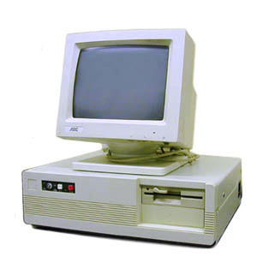
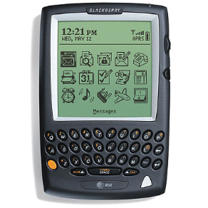
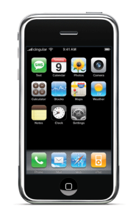

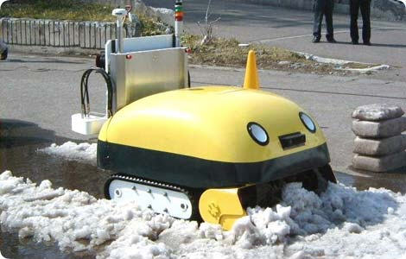






Internet evolution cont.
Devices:
Network:
Time period:
1980’s
1990’s
Now
Near future
Notes:
Fiber Optic Service

Slide 5
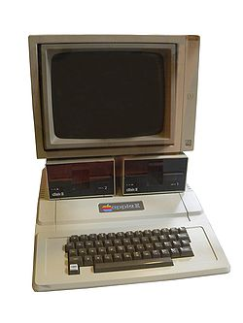
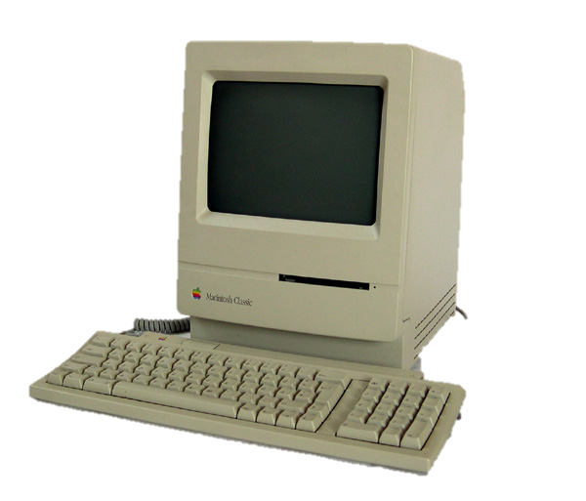
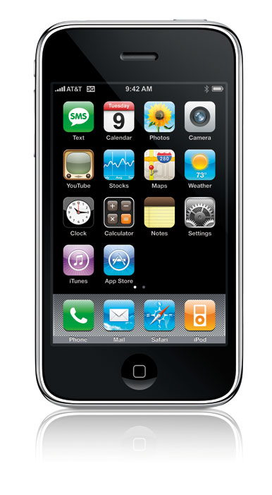
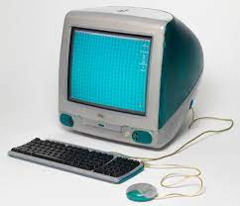
Internet evolution cont.
What types of applications have revolutionized Internet functionality?
1980’s
1990’s
2000’s
NOW
E-mail, newsgroups, remote access
Web, e-commerce
Peer-to-peer (P2P), voice-over-IP (VoIP), YouTube, Netflix
Mobile data, social nets and location services, other?
Notes:
Because applications run on end systems, as application developers we only need to worry about those, as opposed to all the functionality of the network stack in the core

Slide 6
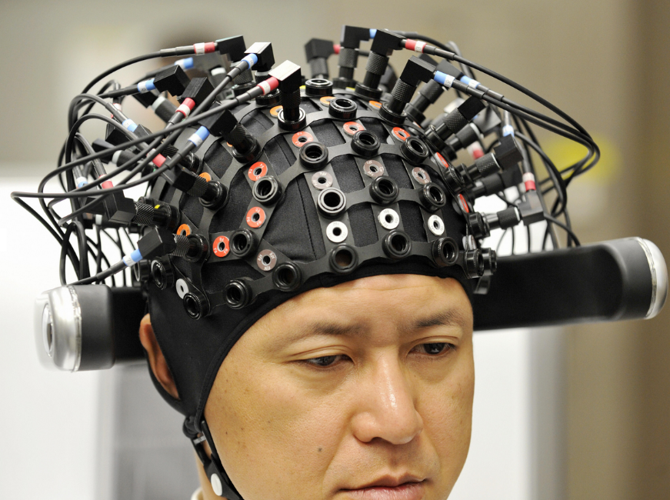
Modern Internet
What technologies or developments to do see changing the Internet today?
Fiber to home
Unlimited bandwidth?
5G - ultra-low latency
Autonomous devices
So much traffic!
Brain to brain communication
http://www.independent.co.uk/news/science/hola-at-your-brain-first-braintobrain-interface-is-a-step-towards-digital-telepathy-9714486.html

Slide 7
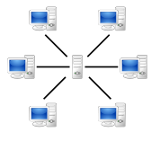


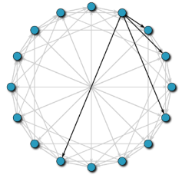

Network application architectures
Client-Server
Hybrids
Peer-to-Peer
System Scalability
System Complexity
+ Control
– Scalability
– Availability
+ Control
+ Scalability
– Cost
+ Scalability
+ Cost
+ Availability
– Control
– ISP friendliness
– Security
Notes:
? Arch for OSN: hybrid – nearby servers support local communications
? Arch for Google maps: centralized query processing (cheaper, not too slow), tiles distributed onto CDNs

Slide 8
Application requirements
What types of services do different applications need from the network?
Application
Data loss
Throughput
Time sensitive
no loss/loss-tolerant?
elastic/inelastic
yes/no
file transfer
e-mail
Web browsing
real-time audio
stored video
interactive games
text messaging
no loss
no loss
loss-tolerant
loss-tolerant
loss-tolerant
no loss
no loss
elastic
elastic
inelastic
elastic
inelastic
elastic
elastic
no
no → yes
yes
no
yes
no
no
Notes:
Fill in the table and discuss

